Slide 1
Hello Problems!
Prove that 0.99999 = 1
Disprove the “proof” that 2 = 1 (see slide #5)
Prove the Pythagorean Theorem
Sum the first 2,000 odd multiples of 7
Prove that no square integer has a remainder of 3 when divided by 5
Demonstrate geometrically what “square” is completed when solving a quadratic equation
Derive an algebraic expression to calculate the shortest distance between a line (y₁ = mx₁ + b) and a point (x₂,y₂) not on that line

Slide 2
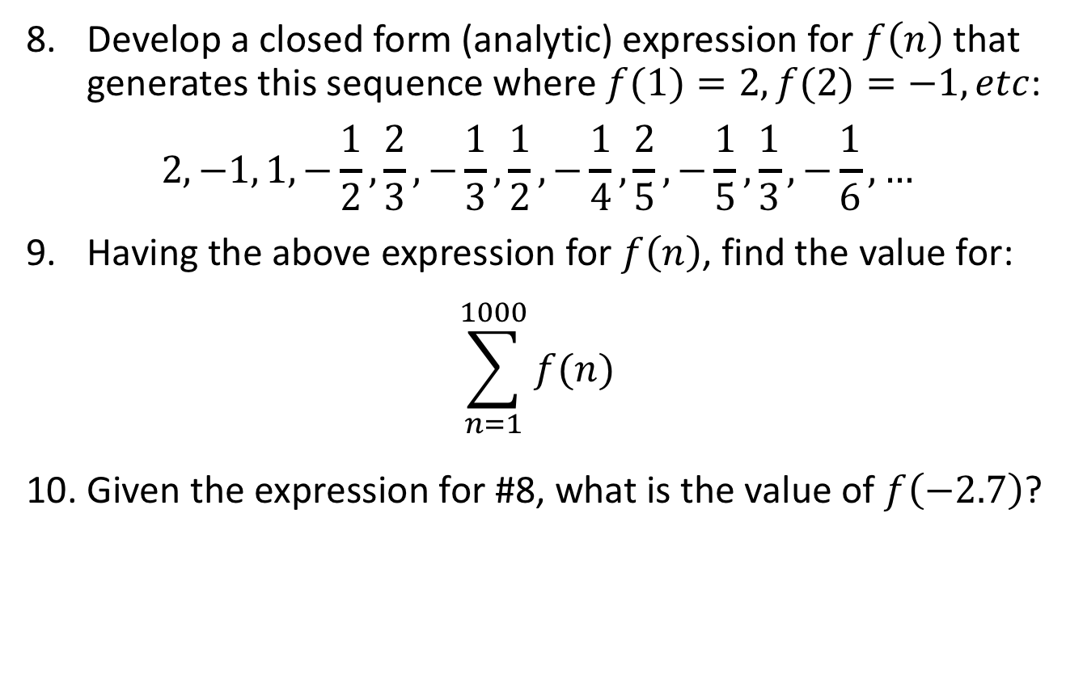
Hello Problems!
Develop a closed form (analytic) expression for $f\left(n\right)$ that generates this sequence where $f(1)=2,f(2)=−1, etc$:
$$2, −1, 1, −\frac{1}{2}, \frac{2}{3},−\frac{1}{3},\frac{1}{2}, −\frac{1}{4},\frac{2}{5},−\frac{1}{5},\frac{1}{3},−\frac{1}{6}, …$$
Having the above expression for $f\left(n\right)$, find the value for:
$$\sum_{n=1}^{1000}{f(n)}$$
Given the expression for #8, what is the value of $f\left(−2.7\right)$?

Slide 3
Hello Problems!
The classic equation for a line: $y=mx+b$ cannot represent a vertical line since neither of the available unknowns $(m,b)$ are coefficients of the $y$ term.
The Radon projection is an equation having only two unknowns $\left(θ,d\right)$ that can represent any and all lines, including both horizontal and vertical lines
$$x\cos{θ}+y\sin{θ}=d, where \left\{θ,d∈ℝ\right\}$$
$$and −∞≤d≤∞, 0≤θ<π$$
Find the equation $x=f(θ,d,r)$ that represents the intersection of the Radon line and the circle $x^{2}+y^{2}=r^{2}$

Slide 4
Answers

Slide 5
(#1) .99999 equals 1
x = 0.9999999
−
10x = 9.9999999
-9x = -9
x = 1

Slide 6
(#2) – Where did we go wrong?
a = b
a² = ab
a² + (a² – 2ab) = ab + (a² – 2ab)
2(a² – ab) = (a² – ab)
2 = 1
Since a = b (given) then a² - ab = 0, thus we have illegally divided by zero

Slide 7
(#3)
Prove: a² + b² = c²
c
a
b

Slide 8
Prove: a² + b² = c²
c
c
a
b
b
a

Slide 9
Prove: a² + b² = c²
b
a
c
c
c
a
b
b
a

Slide 10
Prove: a² + b² = c²

Slide 11
Prove: a² + b² = c²
Area of Outer Square
(a + b)² = a² + 2ab + b²
a
b
a
b
a
b
b
a

Slide 12
Prove: a² + b² = c²
Area of Outer Square
(a + b)² = a² + 2ab + b²
Area of Inner Triangles
4 × [(a × b) / 2] = 2ab
a
b
a
b
a
b
b
a

Slide 13
Prove: a² + b² = c²
Area of Outer Square
(a + b)² = a² + 2ab + b²
Area of Inner Triangles
4 × [(a × b) / 2] = 2ab
Area of Inner Square
c²
c
c
c
c

Slide 14
Prove: a² + b² = c²
Area of Outer Square
(a + b)² = a² + 2ab + b²
Area of Inner Triangles
4 × [(a × b) / 2] = 2ab
Area of Inner Square
c²
Area of Outer Square – Area of Triangles =
Area of Inner Square
[a² + 2ab + b²] – 2ab = c²
a² + b² = c²
a
b
a
b
c
c
c
c
a
b
b
a

Slide 15
(#4) Sum of first 2,000 odd multiples of 7
7, 21, 35, 49, 63, ….
1st odd multiple = 7
2nd odd multiple = 21
3rd odd multiple = 35
n^{th} multiple = 7(2n – 1)
2,000th odd multiple = 7(2 • 2,000 - 1)
= 27,993

Slide 16
(#4) Sum of first 2,000 odd multiples of 7

Slide 17
(#5) N ≡ 3 mod 5 iff N not square
Prove that no square integer has a remainder of 3 when divided by 5
Every number can be represented in one
(and only one) of these two forms:
x = 2n
x = 2n + 1
Every number can be represented in one
(and only one) of these five forms:
x = 5n
x = 5n + 1
x = 5n + 2
x = 5n + 3
x = 5n + 4

Slide 18
(#5) N ≡ 3 mod 5 iff N not square
Prove that no square integer has a remainder of 3 when divided by 5
Form | Form² | (Form²) mod 5
5n | 25n² | 0
(5n+1) | 25n² + 10n + 1 | 1
(5n+2) | 25n² + 20n + 4 | 4
(5n+3) | 25n² + 30n + 9 | 4
(5n+4) | 25n² + 40n + 16 | 1
To be a square number, it must have remainders of
0, 1, or 4 when divided by 5.
If it has a remainder of 2 or 3, it is NOT a square number!

Slide 19
(#6) Completing What Square?
$$ax^{2}+bx+c=0$$
$$ax^{2}+bx=−c$$
$$\frac{1}{a}\left(ax^{2}+bx\right)=\frac{1}{a}\left(−c\right)$$
$$x^{2}+\frac{b}{a}x=\frac{−c}{a}$$

Slide 20
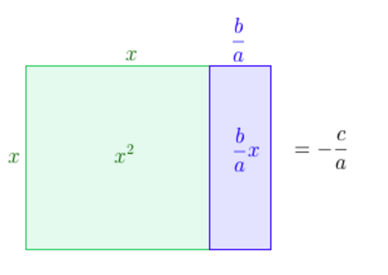
(#6) Completing What Square?
$$x^{2}+\frac{b}{a}x=\frac{−c}{a}$$

Slide 21
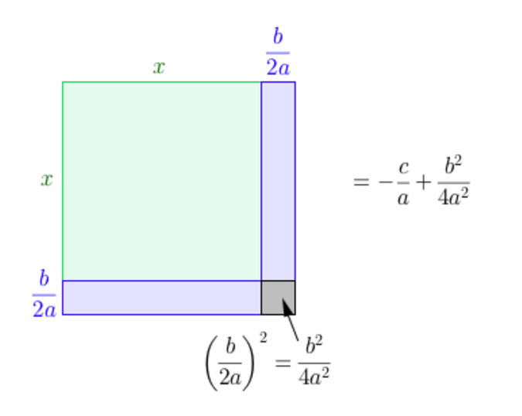
(#6) Completing What Square?
That square!

Slide 22
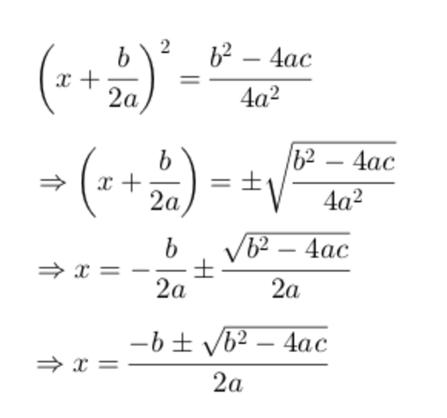
(#6) Completing What Square?

Slide 23
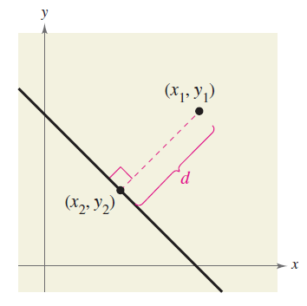
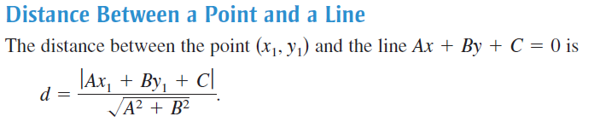
(#7) Distance Between Point and a Line

Slide 24
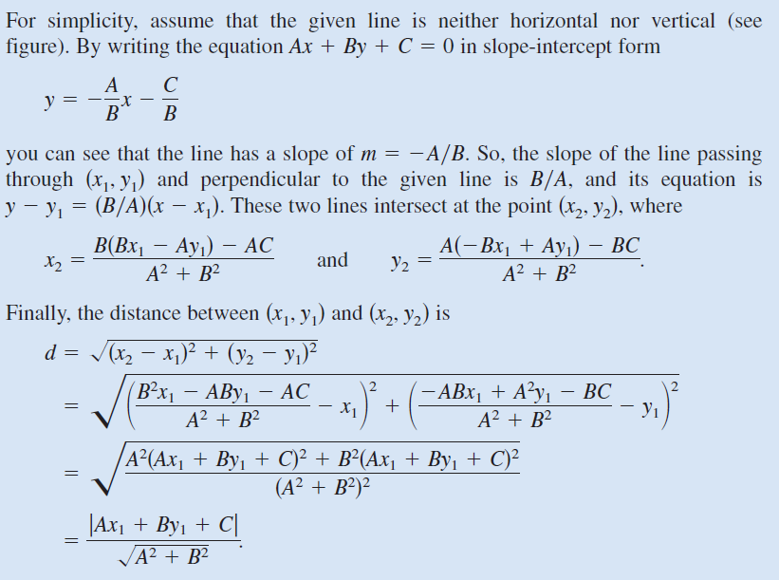
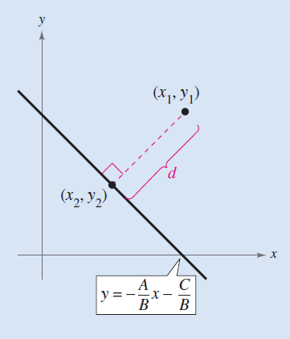
(#7) Distance Between Point and a Line

Slide 25
(#8) Series Functional Equation
Find the underlying functional equation that generates this series, $where n≥1 and a_{1}=2,a_{2}=−1,etc$:
$$a_{n}=2, −1, 1, −\frac{1}{2},\frac{2}{3},−\frac{1}{3},\frac{1}{2},−\frac{1}{4},\frac{2}{5},−\frac{1}{5},\frac{1}{3},−\frac{1}{6},…$$
Hint: Rewrite some terms as un-simplified fractions – what pattern do you now see in the numerators & denominators?
$$a_{n}=\frac{2}{1}, \frac{−1}{1},\frac{2}{2}, \frac{−1}{2},\frac{2}{3}, \frac{−1}{3},\frac{2}{4}, \frac{−1}{4},\frac{2}{5}, \frac{−1}{5},\frac{2}{6}, \frac{−1}{6},…$$

Slide 26
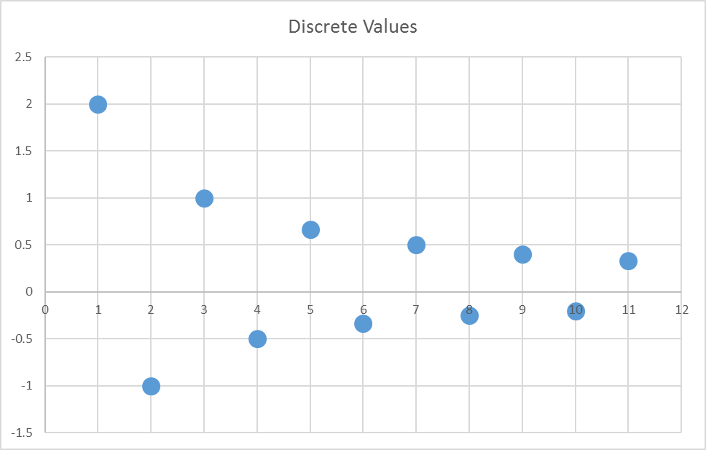
$$a_{n}=f\left(n\right)=2, −1, 1, −\frac{1}{2},\frac{2}{3},−\frac{1}{3},\frac{1}{2},−\frac{1}{4},\frac{2}{5},−\frac{1}{5},\frac{1}{3},−\frac{1}{6},…$$
Does the sum of this sequence converge or is it divergent ?

Slide 27
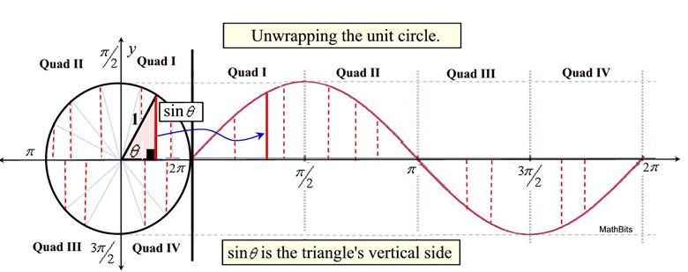
An Analytic Mod Operator
Can we develop a formula for $f\left(n\right) \{n∈ℤ^{+}\}$ such that
$$f\left(n\right)↦n \% 2=\left\{\begin{matrix} 0, n even \\ 1, n odd\end{matrix}\right.$$
We need a function that alternates (oscillates) between a bounded range of values, ultimately returning to where it starts, and then it just keeps repeating over and over…

Slide 28
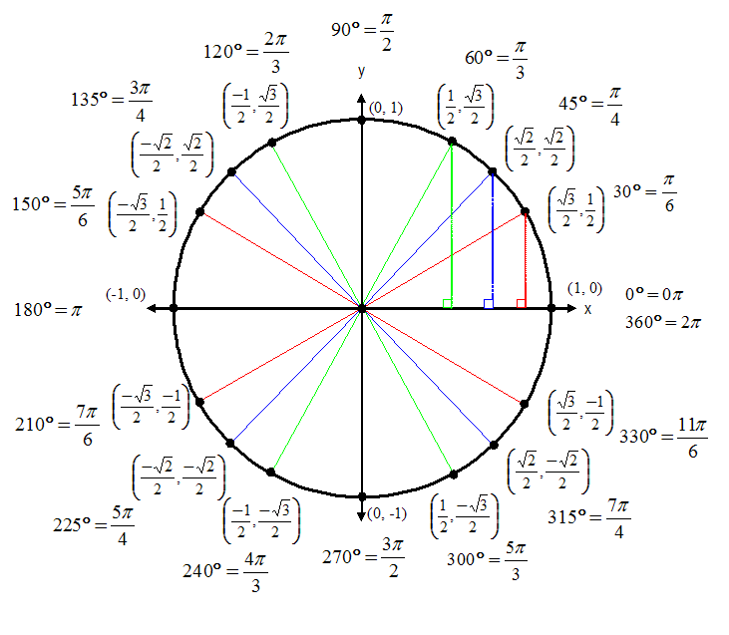
An Analytic Mod Operator
$$f\left(n\right)=\sin^{2}\left(\frac{nπ}{2}\right) \{n∈ℤ^{+}\}$$
$$n$$ | $$\sin^{2}\left(\frac{nπ}{2}\right)$$
1 | 1
2 | 0
3 | 1
4 | 0
5 | 1
$$f\left(n\right)=\sin^{2}\left(\frac{nπ}{2}\right)=n mod 2 \{n≥1\}$$

Slide 29
Series Functional Equation
Find the underlying functional equation that generates this series, $where n≥1 and a_{1}=2,a_{2}=−1,etc$:
$$a_{n}=\frac{2}{1}, \frac{−1}{1},\frac{2}{2}, \frac{−1}{2},\frac{2}{3}, \frac{−1}{3},\frac{2}{4}, \frac{−1}{4},\frac{2}{5}, \frac{−1}{5},\frac{2}{6}, \frac{−1}{6},…$$

Slide 30
Series Functional Equation
$$a_{n}=\frac{2}{1}, \frac{−1}{1},\frac{2}{2}, \frac{−1}{2},\frac{2}{3}, \frac{−1}{3},\frac{2}{4}, \frac{−1}{4},\frac{2}{5}, \frac{−1}{5},\frac{2}{6}, \frac{−1}{6},…$$
$$a_{n}=\frac{2\left[{\left(−1\right)}^{n+1}∗ 2^{\left(\sin^{2}\left(\frac{nπ}{2}\right)\right)}\right]}{\left[n+\sin^{2}\left(\frac{nπ}{2}\right)\right]}$$

Slide 31
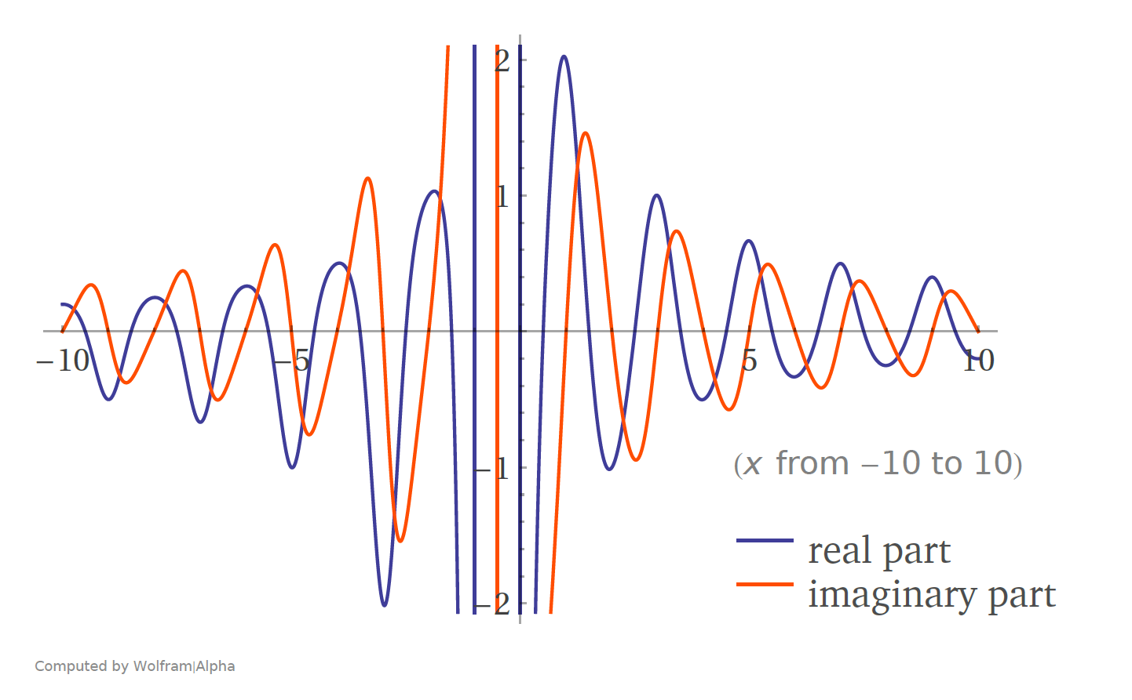
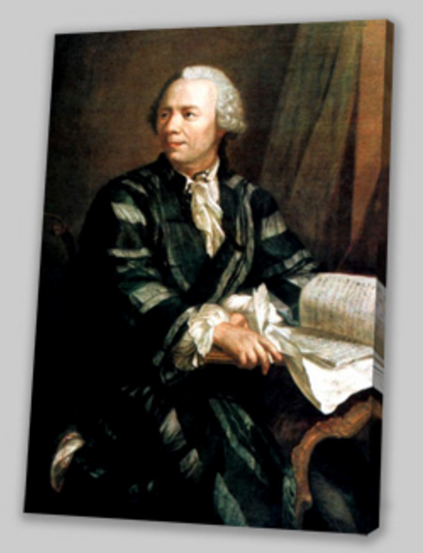
Analytic Continuation “Domain Stretching”
1$, 2, 3, 4, 5, 6\text{, 7, 8,} \text{9, } \text{10,} \text{11, 12,…}$
$$x∈ℝ$$
$$2, −1, 1, −\frac{1}{2},\frac{2}{3},−\frac{1}{3},\frac{1}{2},−\frac{1}{4},\frac{2}{5},−\frac{1}{5},\frac{1}{3},−\frac{1}{6},…$$
$$f(n)=\frac{2\left[{\left(−1\right)}^{n+1}∗ 2^{\sin^{2}\left(\frac{nπ}{2}\right)}\right]}{\left[n+\sin^{2}\left(\frac{nπ}{2}\right)\right]}$$
$$f\left(2\right)=−1$$
$$f\left(6\right)=−\frac{1}{3}$$
$$f\left(123456\right)=−\frac{1}{61728}$$
$$f\left(π\right)=0.853+0.407i$$
$$f\left(−2.7\right)=−1.069−1.472i$$
The sum is divergent!
$$g\left(y\right)=\sum_{x=1}^{y}{f(x)}$$
$$g\left(1,000\right)=6.793 \\ g\left(100,000\right)=11.397 \\ g\left(1,000,000\right)=13.7$$
#9
#10
$$h\left(x\right)=\int_{1}^{x}{f(x)ⅆx}$$
$$h\left(2\right)=0.214+0.913i \\ h\left(π\right)=0.367+0.333i$$
Be like Euler!

Slide 32
(#11) Universal Equation for a Line
The classic equation for a line: $y=mx+b$ cannot readily represent a vertical line since neither of the two available unknowns $(m,b)$ are coefficients of the $y$ term
The Radon projection is an equation also having only two unknowns $\left(θ,d\right)$ but it can represent any and all lines, including both horizontal and vertical lines
$$x\cos{θ}+y\sin{θ}=d, where \left\{θ,d∈ℝ\right\}$$
$$and −∞≤d≤∞, 0≤θ<π$$
Challenge: Find the equation $x=f(θ,d,r)$ that represents the intersection of a Radon line and a circle $x^{2}+y^{2}=r^{2}$

Slide 33
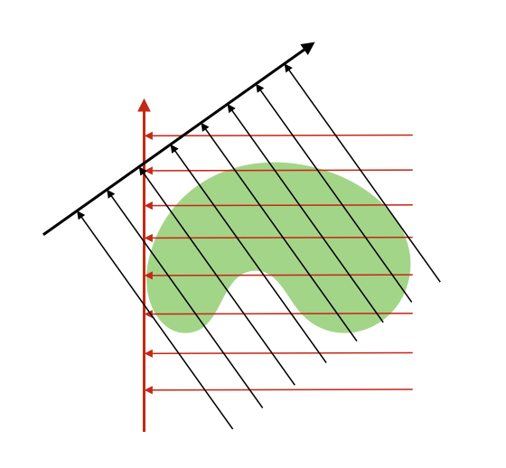
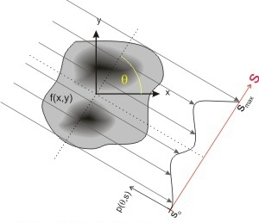
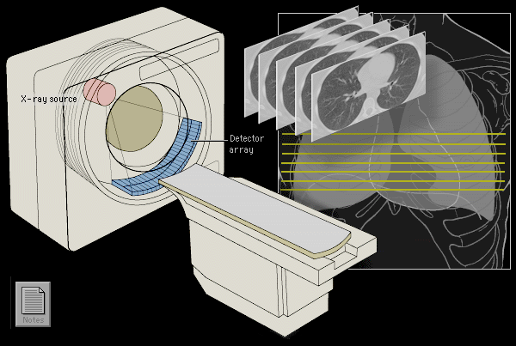
Why care about the “Radon” transform?
Because it is the basis for all CAT and PET scans in the medical field
It is also the foundation for computer vision in autonomous vehicles and 3D face recognition

Slide 34
Intersection of Radon Projection and Circle
$$x\cos{θ}+y\sin{θ}=d∩x^{2}+y^{2}=r^{2}$$

